Slide 1
Sign Language
MNIST
Drop-In Replacement for MNIST
for Hand Gesture Recognition Tasks

Slide 2
GROUP 04
Shakib Khan
1711661042
Fahim Uddin
1711747042
Iftekhar Alam Pial
1410213642
Md. Niaz Mahmud Shihab 1721274042

Slide 3
What is Sign Language MNIST ?
Here’s what you’ll find in this :
We all know the basic Handwritten Digits MNIST is the ‘Hello World’ of Machine Learning. In our project, instead of having digits, our dataset contains Alphabets as an emblem form.
The Sign Language letter database of hand gestures represent a multi-class problem with 24 classes of letters (excluding J and Z which require motion).
Find the dataset:
Kaggle : https://www.kaggle.com/datamunge/sign-language-mnist
Github : https://github.com/mon95/Sign-Language-and-Static-gesture-recognition-using-sklearn

Slide 4
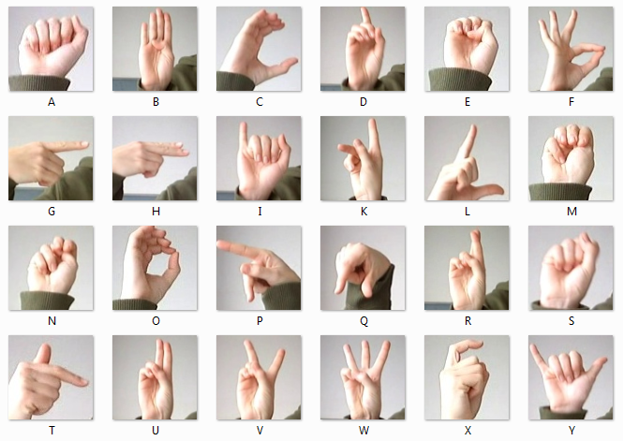
HAVE A LOOK
Here is the insight of our data

Slide 5
DATASET
Here’s what you’ll find about this dataset :
The Sign Language MNIST is presented with the CSV format with labels and pixel values in single rows.
Each training and test case represents a label (0-25) as a one-to-one map for each alphabetic letter A-Z but and no cases for 9=J or 25=Z because of gesture motions.
The training data and test data with a header row of label like, pixel1, pixel2, pixel3..….pixel784 which represent a single 28x28 pixel image with grayscale values between 0-255.

Slide 6
DATA SPLIT
Train Data (27,455 cases)
Test Data (7172 cases)

Slide 7
Propose Method
Convolutional Neural Network (CNN)
Conv2D
Max Pooling
Dropout
Normalization
Layer Activation (‘Relu’)
Output Layer Activation (‘Softmax’)

Slide 8




LIBRARIES & FRAMEWORK
Numpy
Tensorflow
Keras
Google Colab

Slide 9
DATA VISUALIZATION
Matplotlib
Seaborn
Confusion Matrix

Slide 10
OUR PROCESS
01
02
03
Prediction
Data Processing
Build CNN Model
After train the model we will predict with test data
Rescale our data and normalize them and visualize
Here we train our csv data with CNN

Slide 11
EVALUATE LEARNING CURVE
This learning curves of model performance on the train and validation datasets can be used to diagnose an underfit, overfit, or well-fit model.
After training our model we want to see how our model learn from our training data over an epochs.
By Evaluating this, we can tell is our model well-fit or not.

Slide 12
THANKS
Do you have any questions?

